Slide 1

Genetics 10
For educators
Joan Alcaide-Núñez – August 2024

Slide 2
Why should I use it?
Topic: Genetics and Bioinformatics
Built from the scholar curriculum
Interactive & active learning
Customizable & adaptable → easier to use
First-person engaging
Applied activity promotes critical thinking & problem-solving skills
Collaboration, team projects and communication

Slide 3

Why should I use it?
Web-based
No installation required → good for school-managed devices
OS-agnostic
No coding knowledge required
Scalable tool

Slide 4
How can I use it?
Explain fundamental concepts of genomics
Identify the time to introduce the software

Slide 5
Challenge-like activities
Leverage it by integrating real-world examples, and challenge-like activities
Promoting critical thinking
Opportunity for teamwork

Slide 6
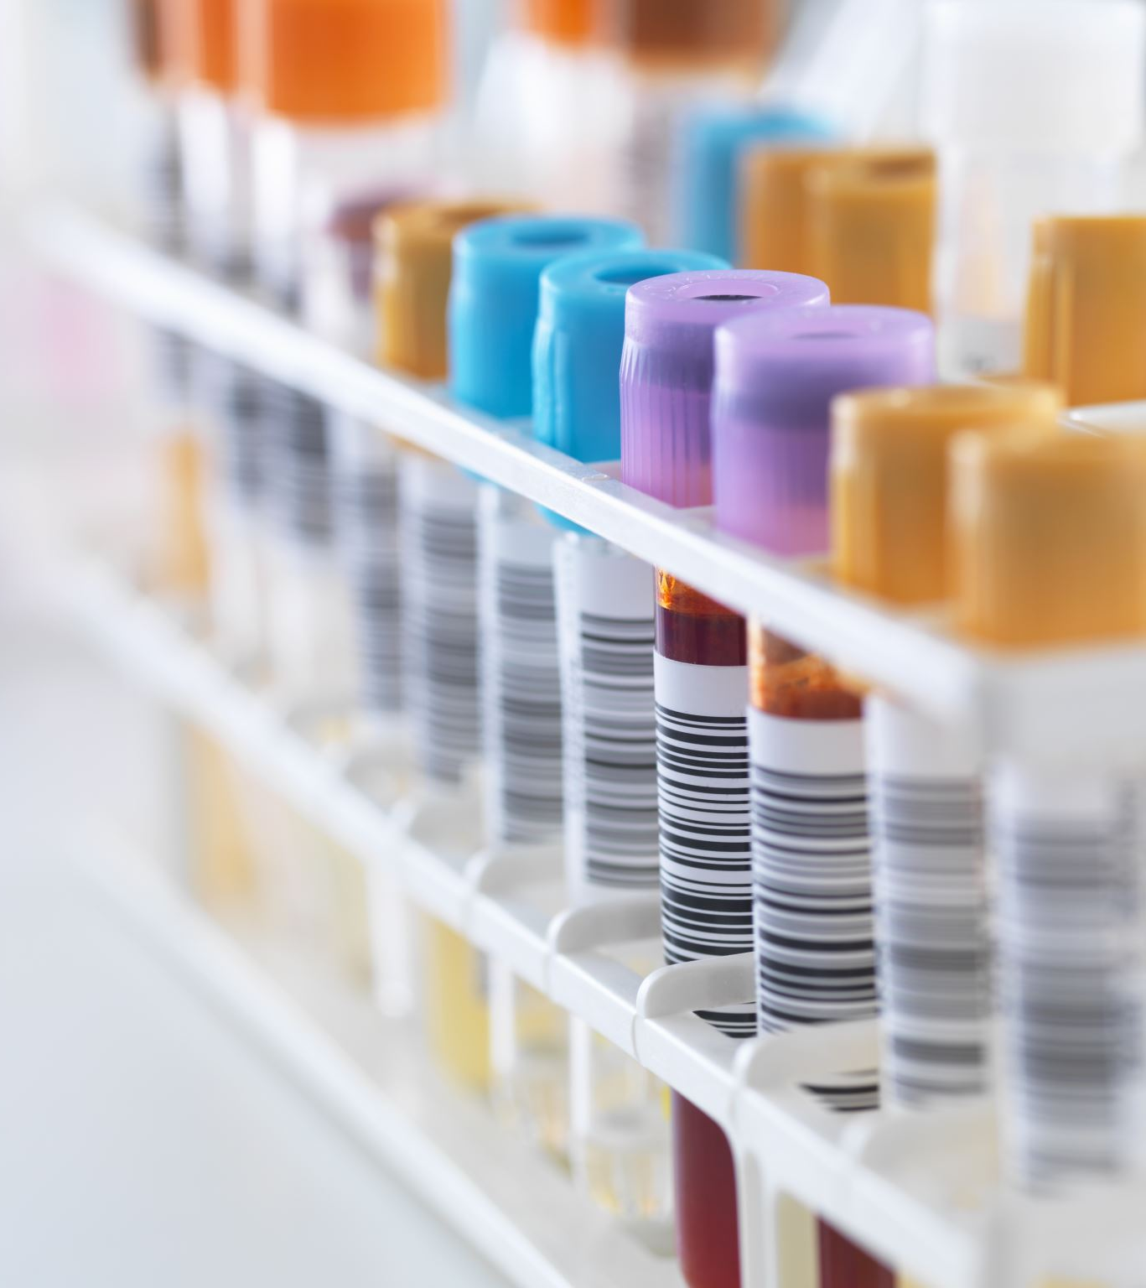
Correct mutation
“You were given two copies of a gene. One of them has a mutation that causes a disease, you are asked to identify and correct that mutation. Write your own code using the pre-established functions.”
Educators can use the createmutation() function to create DNA or RNA strings.
Students then use the compare() and check() to find mutations. In addition, they can use translate/transcript the string into amino acids to see the effect of mutations.

Slide 7
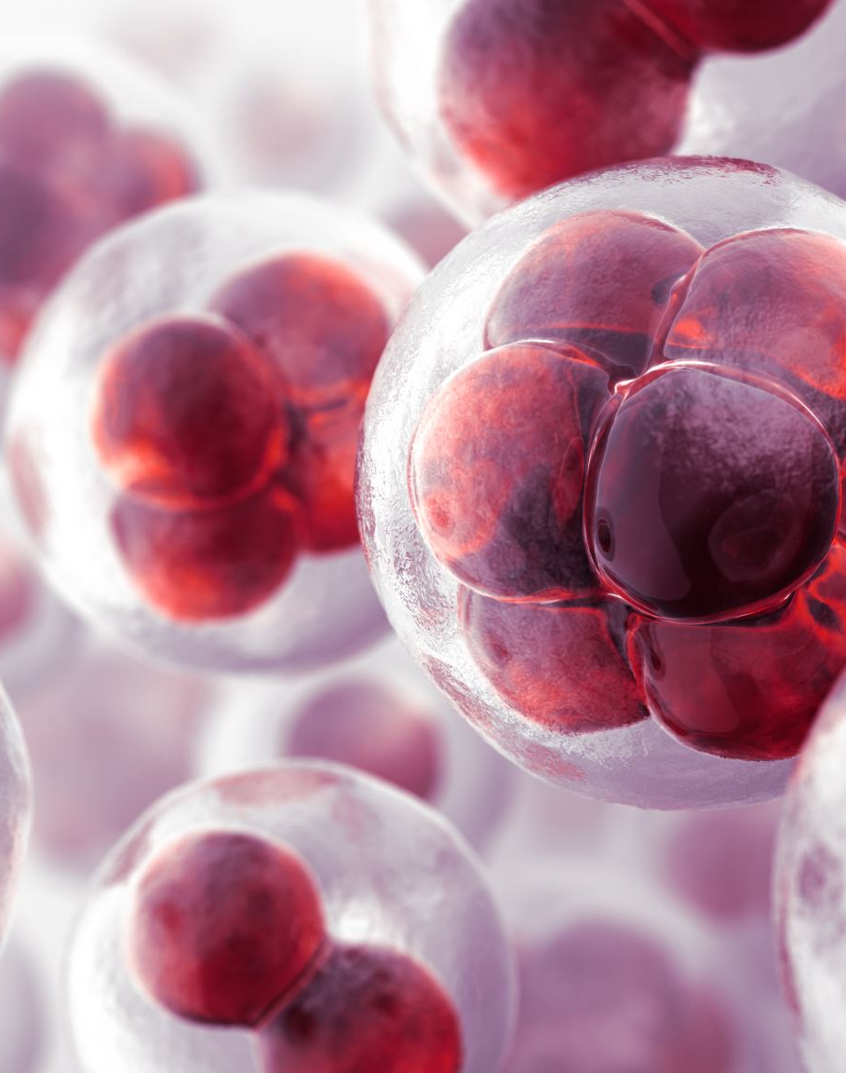
Protein structure
“Researchers have identified a gene mutation causing a disease. To develop a treatment, you want to know how the mutation in the DNA sequence causes changes in the protein structure. Write your code with the pre-established functions.”
Students would use the AlphaFold API to compute the structure of proteins. Then they could use 3D visualization to see the differences.

Slide 8

Heritage or surroundings?
“You are asked to show if a decease is heritable or not. Previous studies have identified the amino acid sequence of the disease protein. At your disposal you are given 10 DNA strings from an ill person.”
Students would need to read literature and extract the amino acid sequence of the malicious protein (optional). Then they will use the iterate() function to compute 10 translations and transcriptions. And the compare() and check() functions to compare the amino acid sequence of the protein with the computed ones. If they are identic, the disease is heritable, otherwise the disease is caused somewhere else.

Slide 9

Flipped classroom
Assigning tutorials as homework
Use class time for interactive and active learning
Maximized classroom engagement
Personalized instruction

Slide 10

Collaboration
Encourage group projects (e.g. create a new function)
Fostering of teamwork and communication skills
Learning from each other

Slide 11

Questions?
Submit a GitHub issue @ github.com/joanalnu/gen10!

